Slide 1

What is Unit testing?
Unit tests are whitebox tests written by developers, and designed to verify small units of program functionality.

Slide 2

When to write unit tests?
Unit tests are written by you, the developer, concurrently with implementation.

Slide 3
Good Unit Testing
Automatic: Run completely by itself, without any human input.
Atomic: Determine by itself whether the function it is testing has passed or failed, without a human interpreting the results
Single responsibility: Test exactly one feature
Independent: Run in isolation, separate from any other test cases (even if they test the same functions)
Repeatable: Multiple invocations of the test should consistently return the same value.

Slide 4

JUnit
Unit testing framework for the Java Programming Language.
Open source ( http://Junit.org )
Framework for both writing and automated execution of unit tests
Can be integrated with eclipse.

Slide 5
JUnit in Action
package edu.siu.cs435;
public class Math
{
public int add(int a, int b) {
return a + b;
}
public int sub(int a, int b) {
return a - b;
}
}

Slide 6
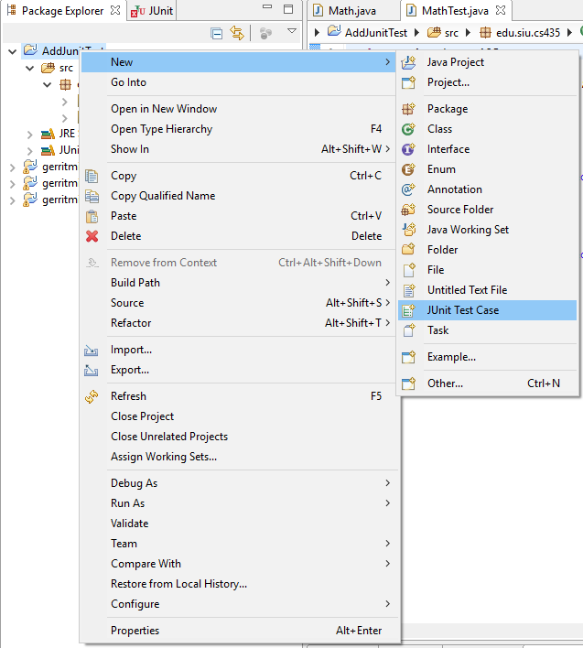
JUnit and Eclipse
To add JUnit to an Eclipse project, click:
  Project → Properties → Build Path → Libraries →
  Add Library... → JUnit → JUnit 4 → Finish
To create a test case:
  right-click a file and
  choose New → Test Case
  or click File → New →
  JUnit Test Case
  Eclipse can create stubs
  of method tests for you.

Slide 7
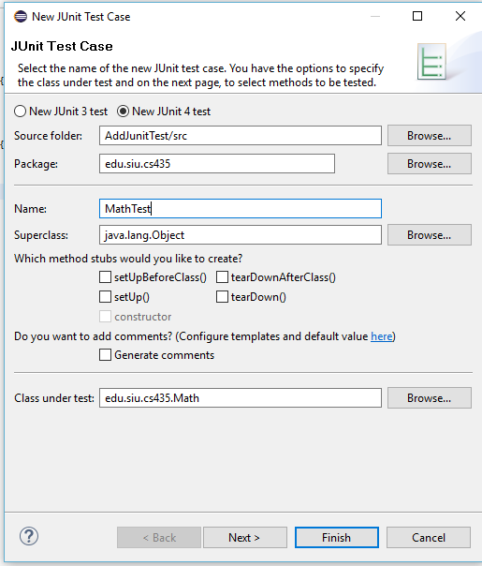
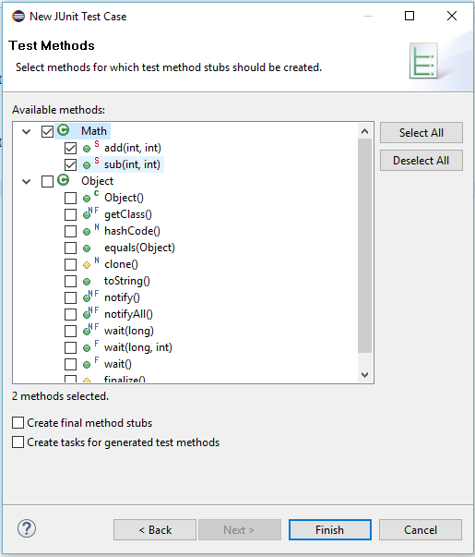
Junit in Eclipse

Slide 8
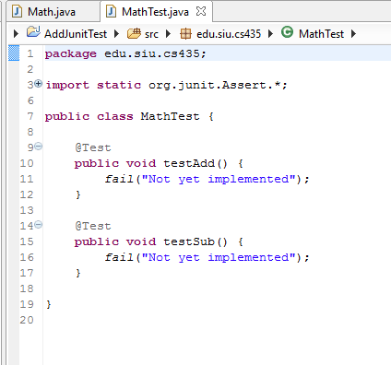

Slide 9
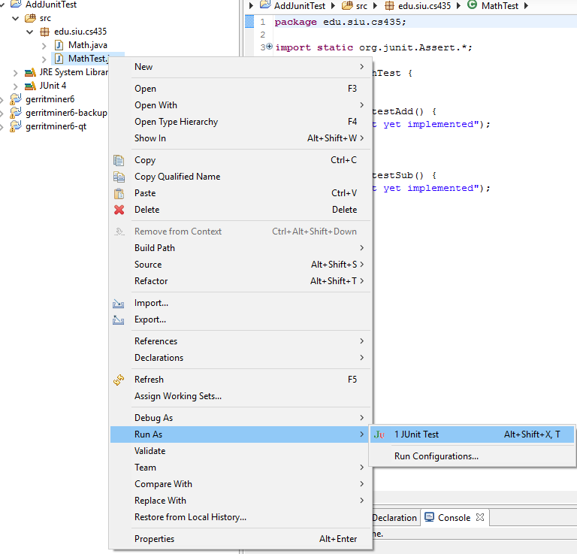

Slide 10
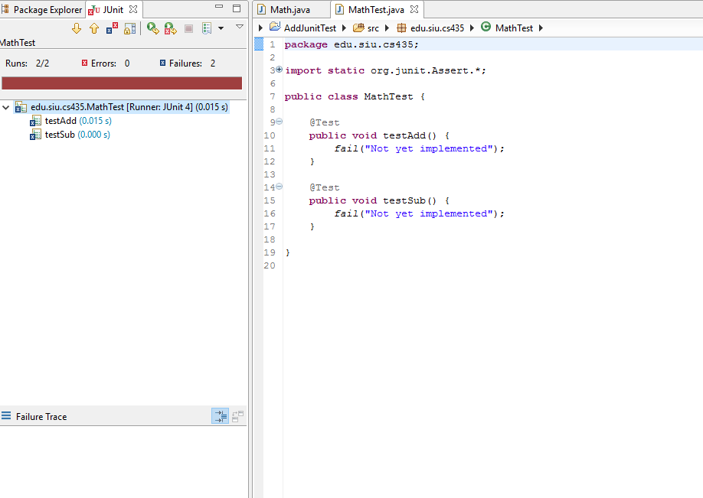

Slide 11
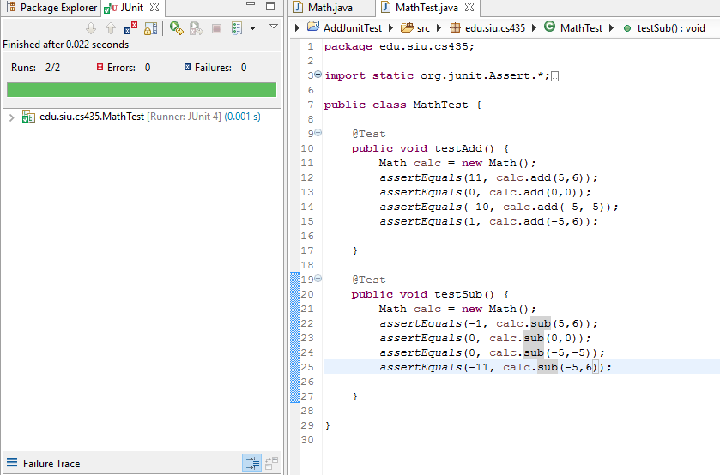

Slide 12
JUnit assertion methods
assertTrue(test) | fails if the boolean test is false
assertFalse(test) | fails if the boolean test is true
assertEquals(expected, actual) | fails if the values are not equal
assertSame(expected, actual) | fails if the values are not the same (by ==)
assertNotSame(expected, actual) | fails if the values are the same (by ==)
assertNull(value) | fails if the given value is not null
assertNotNull(value) | fails if the given value is null
fail() | causes current test to immediately fail
Each method can also be passed a string to display if it fails:
  e.g. assertEquals("message", expected, actual)

Slide 13
Junit Framework
Provides following important features
Fixtures
Test suites
Test runners
JUnit classes

Slide 14
Fixtures
Fixtures is a fixed state of a set of objects used as a baseline for running tests. The purpose of a test fixture is to ensure that there is a well known and fixed environment in which tests are run so that results are repeatable.
@Before
  Performs this function before each test case
  Since each of the tests are independent, each test will receive its own instance of whatever is created in the @Before methods
@Test
  Indicates individual test cases
  Must be present to tell JUnit which methods are tests and which are helpers
@After
  The teardown after each test case
  Usually need to worry about this only if you have created external resources

Slide 15
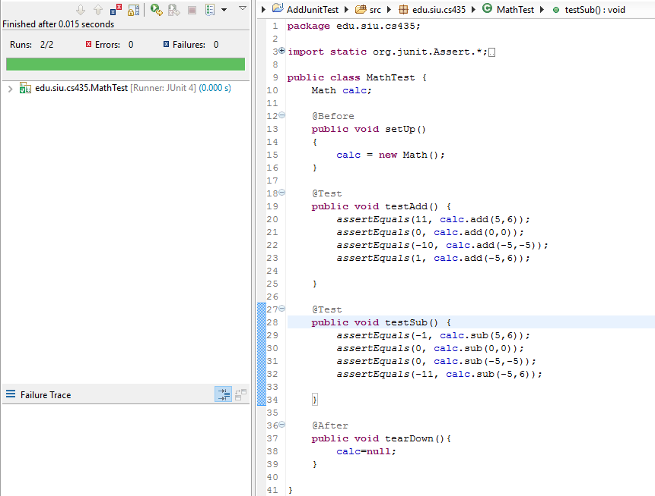

Slide 16
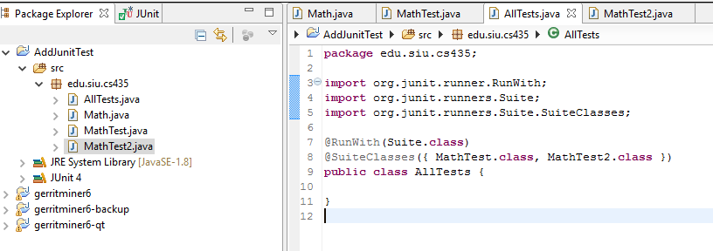
Test Suite
Test suite means bundle a few unit test cases and run it together. In JUnit, both @RunWith and @Suite annotation are used to run the suite test.

Slide 17
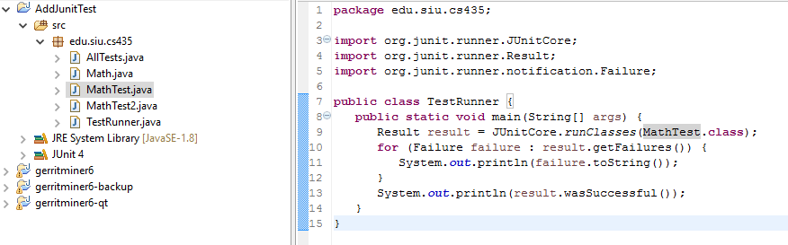
Test Runner
Test runner is used for executing the test cases.

Slide 18
JUnit exercise
Given a Date class with the following methods:
  public Date(int year, int month, int day)
  public Date() // today
  public int getDay(), getMonth(), getYear()
  public void addDays(int days) // advances by days
  public int daysInMonth()
  public String dayOfWeek() // e.g. "Sunday"
  public boolean equals(Object o)
  public boolean isLeapYear()
  public void nextDay() // advances by 1 day
  public String toString()
Come up with unit tests to check the following:
  That no Date object can ever get into an invalid state.
  That the addDays method works properly.
    It should be efficient enough to add 1,000,000 days in a call.
Notes:
a good equals method has some initial checks like checking for null, checking whether this == that, check instanceof, etc... then it calls compareTo

Slide 19
What's wrong with this?
public class DateTest {
@Test
public void test1() {
Date d = new Date(2050, 2, 15);
d.addDays(4);
assertEquals(d.getYear(), 2050);
assertEquals(d.getMonth(), 2);
assertEquals(d.getDay(), 19);
}
@Test
public void test2() {
Date d = new Date(2050, 2, 15);
d.addDays(14);
assertEquals(d.getYear(), 2050);
assertEquals(d.getMonth(), 3);
assertEquals(d.getDay(), 1);
}
}

Slide 20
Well-structured assertions
public class DateTest {
@Test
public void test1() {
Date d = new Date(2050, 2, 15);
d.addDays(4);
assertEquals(2050, d.getYear()); // expected
assertEquals(2, d.getMonth()); // value should
assertEquals(19, d.getDay()); // be at LEFT
}
@Test
public void test2() {
Date d = new Date(2050, 2, 15);
d.addDays(14);
assertEquals("year after +14 days", 2050, d.getYear());
assertEquals("month after +14 days", 3, d.getMonth());
assertEquals("day after +14 days", 1, d.getDay());
} // test cases should usually have messages explaining
} // what is being checked, for better failure output

Slide 21
Expected answer objects
public class DateTest {
@Test
public void test1() {
Date d = new Date(2050, 2, 15);
d.addDays(4);
Date expected = new Date(2050, 2, 19);
assertEquals(expected, d); // use an expected answer
} // object to minimize tests
// (Date must have toString
@Test // and equals methods)
public void test2() {
Date d = new Date(2050, 2, 15);
d.addDays(14);
Date expected = new Date(2050, 3, 1);
assertEquals("date after +14 days", expected, d);
}
}

Slide 22
Naming test cases
public class DateTest {
@Test
public void test_addDays_withinSameMonth_1() {
Date actual = new Date(2050, 2, 15);
actual.addDays(4);
Date expected = new Date(2050, 2, 19);
assertEquals("date after +4 days", expected, actual);
}
// give test case methods really long descriptive names
@Test
public void test_addDays_wrapToNextMonth_2() {
Date actual = new Date(2050, 2, 15);
actual.addDays(14);
Date expected = new Date(2050, 3, 1);
assertEquals("date after +14 days", expected, actual);
}
// give descriptive names to expected/actual values
}

Slide 23
What's wrong with this?
public class DateTest {
@Test
public void test_addDays_addJustOneDay_1() {
Date actual = new Date(2050, 2, 15);
actual.addDays(1);
Date expected = new Date(2050, 2, 16);
assertEquals(
"should have gotten " + expected + "\n" +
" but instead got " + actual\n",
expected, actual);
}
...
}

Slide 24
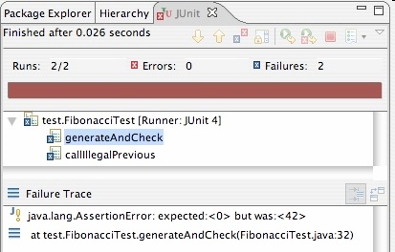
Good assertion messages
public class DateTest {
@Test
public void test_addDays_addJustOneDay_1() {
Date actual = new Date(2050, 2, 15);
actual.addDays(1);
Date expected = new Date(2050, 2, 16);
assertEquals("adding one day to 2050/2/15",
expected, actual);
}
...
}
// JUnit will already show
// the expected and actual
// values in its output;
//
// don't need to repeat them
// in the assertion message

